Slide 1
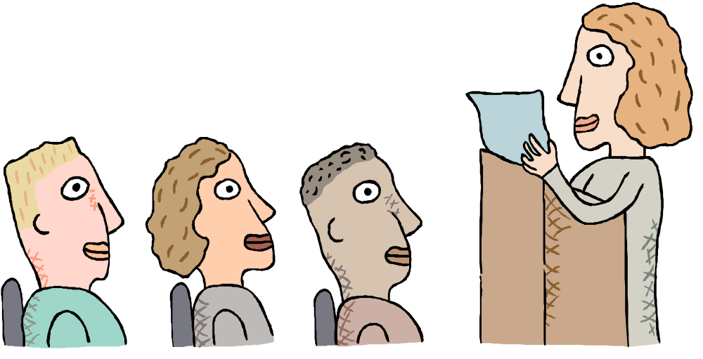
USING AUDIO-VISUAL AIDS

Slide 2
“Great speakers aren’t born, they are trained.”
Presenting is a Skill…
Developed through training and experience

Slide 3
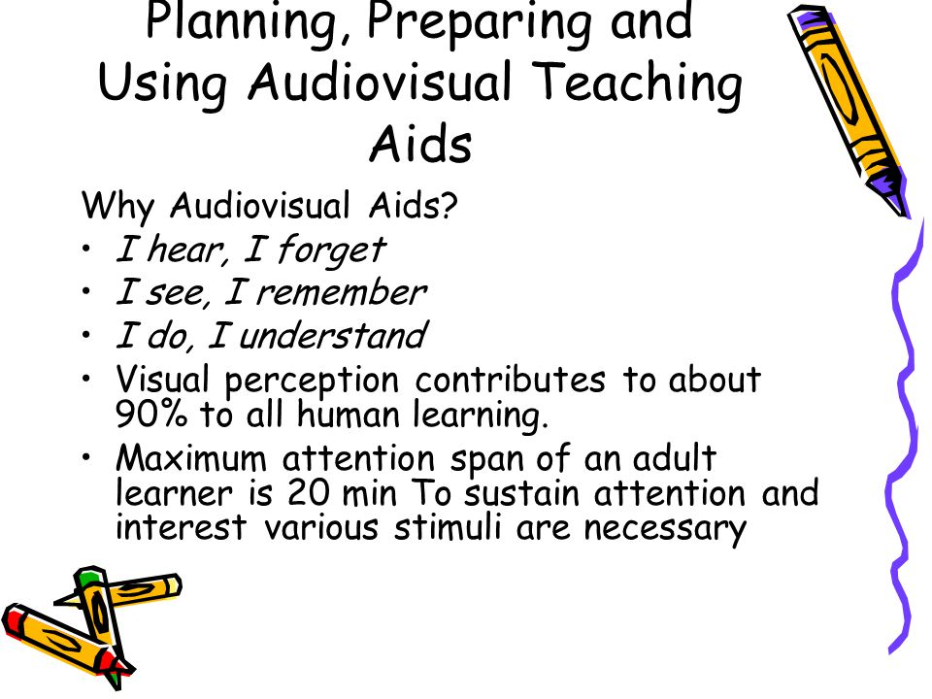

Slide 4
Remember
We acquire 85-90% of all our knowledge visually-sensory motors.
AV aids are all about how you are going to show your audience what you are talking about.

Slide 5
AV Aids
Audiovisual aid - materials using sight or sound to present information.
Almost all presentations can be enhanced by the effective use of visual aids.
Strategically chosen visual aids will serve to illustrate, complement, and reinforce your verbal message.

Slide 6
Warning
Visual develop and convey the message delivered in speech, but they must be used for a specific purpose the audience can easily recognize.
The VA should never become the REASON for the speech.
The VA should be appropriate for the length and format of the speech.
Know what technology will be available to you.
The higher the tech, the more you need redundancy and backup.

Slide 7
Warning
Used poorly, however, they can be a distraction and lead to an ineffective presentation

Slide 8
What AV aids are usually used
PowerPoint slides
Overhead transparencies
Graphs/charts
Pictures
Objects/Models
Films/video
Flip charts
Sketches
Chalk or white board

Slide 9
What AV aids are usually used
The object itself
Models/replicas
Graphs
Word charts
Assorted graphs (pie charts and line graphs etc)

Slide 10
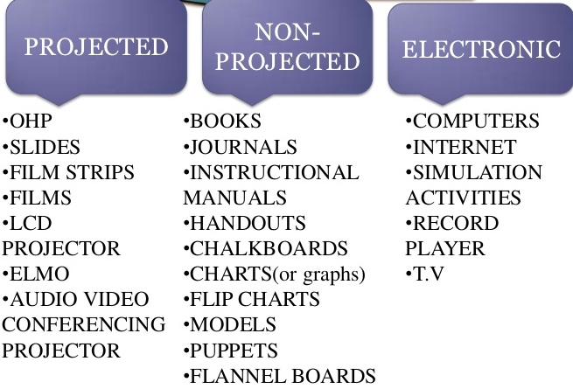

Slide 11
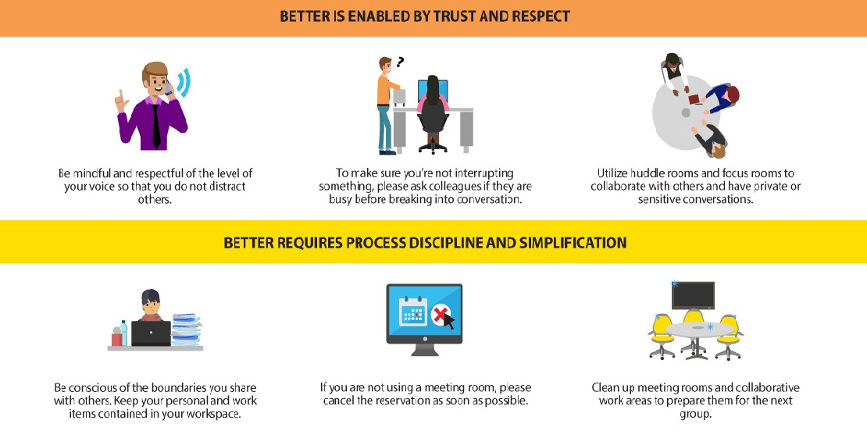
Examples:

Slide 12
Why use AV aids?
Visual aids accomplish several goals:
• Make your speech more interesting
Reinforce what you say.
• Enhance your credibility as a speaker
• To illustrate, complement, and reinforce your verbal message
• Communicate complex or intriguing information in a short period of time
• Help the audience use and retain the information

Slide 13

Why use AV aids?
Enhance understanding
Add variety
Support claims
Lasting impact
Conjure/ visualization

Slide 14
AV Aids Should…
Outline, explain, support main points
Serve audience’s needs, not only speaker’s.
Be simple and clear
Supplement and support, but NOT DOMINATE the presentation

Slide 15
AV Aids Should be…
Clear. Have a clear relationship to the verbal message. Your central goal is to ensure your visual aid is clear. Your audience should “get it” the first time they see it.
Big. They should be legible for everyone, and should be “back row certified.”
Simple. They should serve to simplify the concepts they illustrate.
• Consistent. They should reinforce continuity by using the same visual style.

Slide 16
AV Aids-Don’ts
Do not distract the audience with your visual aid, blocking their view of you or adjusting the visual aid repeatedly while trying to speak.
Do speak to your audience—, the video, or other visual aids should not hinder.
Do not just put videos or pictures for the sake of using them. They would otherwise make you appear incompetent. There must be a relationship between your ideas and the pictures you use. So, avoid irrelevant images and videos.
Avoid small images. Avoid stretching and pixelation. This can make your pictures blur.

Slide 17

Speaker Reads Slides
A speaker may put his entire presentation on his slides. He turns his back to the audience and reads the slides aloud. Perhaps he feels this approach guarantees all the information will get to the audience.
If done continuously, this may be the most annoying way to give a presentation.
The visual presentation dominates the presenter. The presenter is not adding
any value to what is on the slides.
Psst! This slide is way too busy!

Slide 18
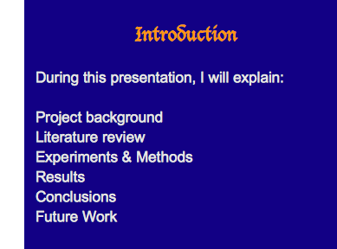
Preparing Effective Slides
Use the first 2-3 slides to:
Introduce your topic
Give the presentation outline
A list of technical words/terms to be used in the presentation if any

Slide 19
Preparing Effective Slides
Select themes, background, color schemes, etc that would suit your topic, audience, and purpose.
Slide background should reflect and emphasize your topic, central ideas, and main ideas.
Different colors tend to have a different impact on a person’s psyche.
For example, the color blue can evoke feelings of trust and confidence in the audience. For this reason, news desks are usually blue.
You can use particular colors to psychologically manipulate the listeners.

Slide 20
Preparing Effective Slides
Select a particular font size and type. Use it with consistency through out the slide show. Do not keep changing font style and type as this can be very disturbing for the audience.

Slide 21
Be Visible
Use Sans Serif fonts (fonts without feet)
  e.g. Arial, Tahoma, Trebuchet, Verdana, etc.
Titles should be 32-44 pt. font size, BOLD
Text should be as large as possible
  First level 24-32 pt font size
  Second level 20-28 pt font size
  Etc.
Use color wisely
  Contrasting colors

Slide 22
Red/Blue Conflict
Red letters on blue background
creates “flicker effect”
Blue letters on red background
just as bad

Slide 23
Low Contrast
White on yellow
Yellow on white
Black on blue
Blue on black

Slide 24

Eye Movement The “Z” Rule
Upper left
Upper right
Lower left
Lower right

Slide 25
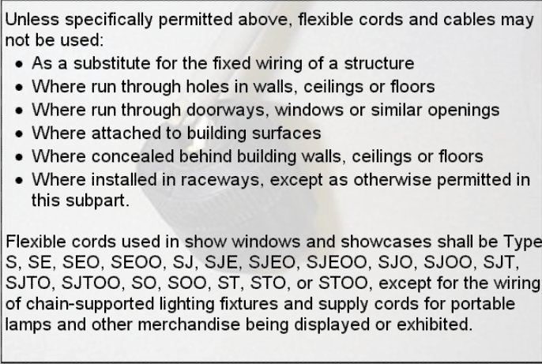
Preparing Effective Slides
Do not overload a slide with information. It is better to use more slides than to clutter a single slide with too much text.
Following are examples of bad and very busy slide.

Slide 26
Preparing Effective Slides
Emphasize key terms or important words by changing font style, type, size, etc.
Do not use paragraphs in slides. Just use headings, prompts, key points, and definitions in the slide.
Use only 4-6 lines of text per VA
Use phrases, not full sentences
Use Upper Case and Lower Case for ease of reading
Limit lines to no more than 30-35 characters

Slide 27
Preparing Effective Slides
Aim for:
  No more than seven words per line.
  No more than seven total lines.
  No more than 30-35 words per slide.

Slide 28

Preparing Effective Slides
Use pictures, charts, diagrams, tables, videos, etc in your slides to achieve the following:
Explain points more effectively
Illustrate a point
Clarify a point
Offer evidence to support a point
Present a point more easily

Slide 29
Preparing Effective Slides
Use special effects and animation to make your presentation more interesting.
General tips to make an amazing slide show:
Keep slides simple
A unique slide design can bring excitement
Add background music
Use inspiring images
Use unique styles to create hype

Slide 30

Good slide vs Bad slide

Slide 31
10 tips for making slides that communicate the idea.
Think about your slides last. Focus on main message, structure its supporting points, practice it and time it—and then start thinking about your slides.
Create a consistent look and feel. the same or related typography, colors and imagery across all your slides.
Think about topic transitions.
With text, less is almost always more.
Use photos that enhance meaning. Use simple, punchy photos that speak strongly to the concept and that aren’t compositionally complex.

Slide 32
10 tips for making slides that communicate the idea.
6. Go easy on the effects and transitions. If you must use them, use the most subtle ones, and keep it consistent.
7. Use masking to direct attention in images. If you want to point something out in a photo, you could use a big arrow.
8. Try panning large images. Pan the illegible/large sized pictures vertically as you talk about it.
9. For video, don’t use autoplay.
10. Reproduce simple charts and graphs

Slide 33
Questions ?

